Slide 1
Cyberminer: Web Search
Engine
Alaa Jalali, Yong hyun Lee, Andres Mancillas, Matthew McCoy, Fionne Tran, Parsa Zilaee

Slide 2
Table of contents
01
Project Overview
03
Design
02
Requirements
04
Cyberminer
The description of the project
Use Case, Sequence, and Class Diagrams
Specify user and system requirements
Overview of Cyberminer implementation

Slide 3
01
Project Overview
The description of the project

Slide 4
Project Overview
Develop a simple web search engine, Cyberminer
Use Object-Oriented Analysis and Design principles
Our team utilized Astah to create UML diagrams
Build a prototype using an Object-Oriented Program
Our team used Python and Flask API for the implementation of the back-end design
Our team used HTML, CSS, and JavaScript for the front-end design
Accessible through team’s web page (GitHub) and/or own device (e.g. PC, laptop)
Overview
Roadmap

Slide 5
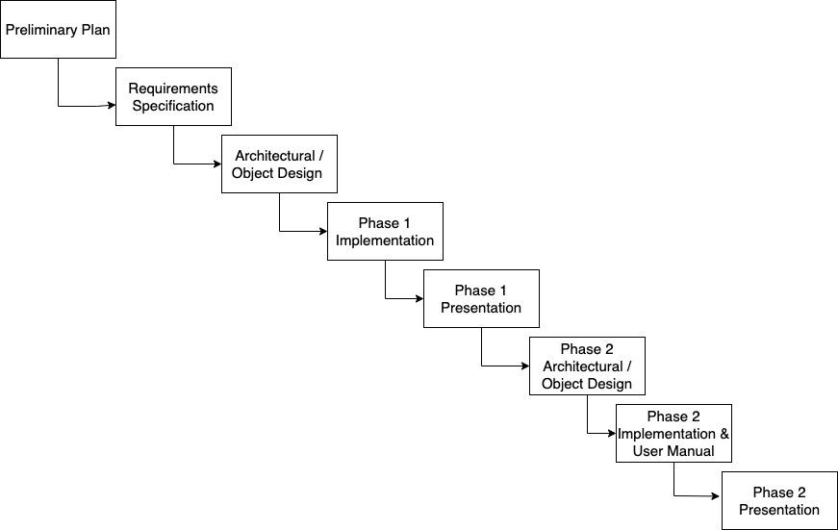
Project Roadmap
Overview
Roadmap

Slide 6
02
Requirements
Specify user and system requirements

Slide 7
Functional Requirements
The Cyberminer System shall:
Accept a list of keywords and return matching URLs
Support case-sensitive search and preserve input format
Enable hyperlink enforcement for easy website navigation
Allow specifying OR/AND/NOT search modes
Run multiple search engines concurrently
Delete outdated URLs and their descriptions
List query results in ascending alphabetical order or other specified criteria
Provide options to set the number of results per page and navigate between pages
Implement autofill and typographical error correction
Filter out non-meaningful symbols based on user configuration

Slide 8
Functional Requirements (cont.)
Stakeholders and Different Features: Organizational users, individual users, advertisers, and Cyberminer administrators are some of the stakeholders in this project. The specific needs and requirements of each stakeholder group are taken into consideration. Different features or functionalities should be provided to cater to distinct requirements given by stakeholders. For example, organizational users might require advanced search options or analytics features, while individual users may prioritize ease of use and personalized settings.
Input and Output Handling: The input of Cyberminer should come from a user interface, whether it's a website or a command line, where keywords can be entered by the user. The input is processed and displays a list of URLs that can be seen by the user in the format of a website or a downloadable file.
Non-Meaningful Symbol Filtering: Users should be able to choose which symbols or characters that can be filtered out from the search keywords, and this can be done using a configuration option. This feature ensures that irrelevant symbols do not affect the search results.

Slide 9
Non-Functional Requirements
The Cyberminer System shall:
Cyberminer should be easily understandable, portable, enhanceable, and reusable
Ensure good performance for efficient search operations
Design the system to be user-friendly, responsive, and adaptable
Maintain the KWIC system's usability and readability

Slide 10
Non-Functional Requirements
Extensions and Clarifications to Non-Functional Requirements:
Usability: Cyberminer is designed with an intuitive interface ensuring an efficient and enjoyable user experience.
User Interface: Cyberminer aims to offer an intuitive, responsive, and user-friendly UI. Clear guidance, feedback, and error messages are pivotal.
Performance: Cyberminer is designed for speed. Efficient search operations, quick load times, and scalability to handle increased traffic are crucial.
Portability & Compatibility: With a vision to be accessible to all, Cyberminer will be compatible across multiple platforms and devices.
Modularity & Enhancements: A modular architecture ensures that future enhancements are smooth. The system's adaptability is key to its long-term success.
Input Handling: Cyberminer accepts inputs from a dedicated user interface. Users can enter keywords to initiate the search process. Extensions include filtering options, advanced search criteria, and preferences.
Output Handling: After processing, Cyberminer displays a list of relevant URLs in a user-friendly format, which can either be viewed online or downloaded as a file for offline use.
Additional Extensions: Options for case-sensitive searches, hyperlink navigation, multi-search engine execution, and automatic filtering of irrelevant symbols.

Slide 11
03
Design
Architectural Design Specification: Use Case, Sequence, and Class Diagrams

Slide 12
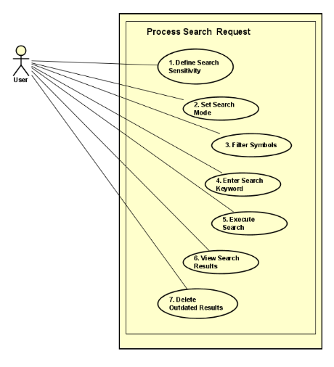
Use Case Diagram
Use Case
Sequence
Class

Slide 13
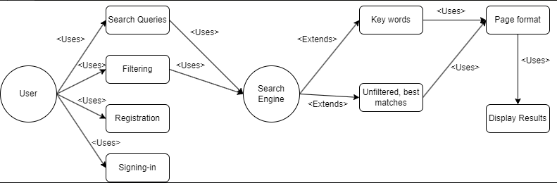
Use Case Diagram
Use Case
Sequence
Class

Slide 14
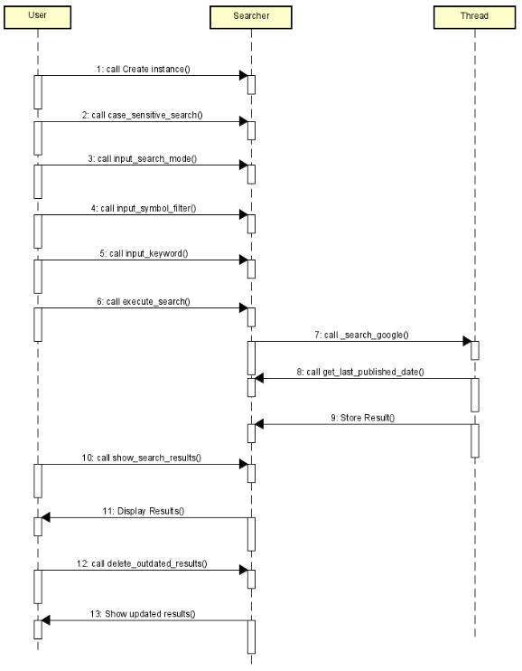
Sequence Diagram
Use Case
Sequence
Class

Slide 15
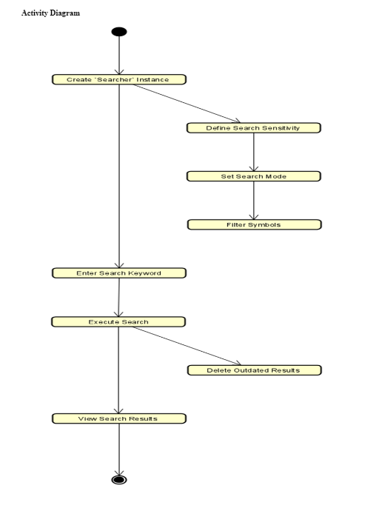
Activity Diagram
Use Case
Sequence
Class

Slide 16
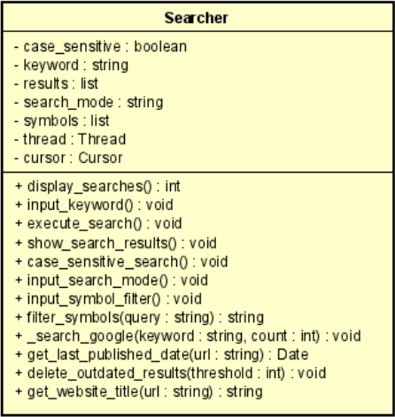
Class Diagram
{Persistent}
Use Case
Sequence
Class

Slide 17
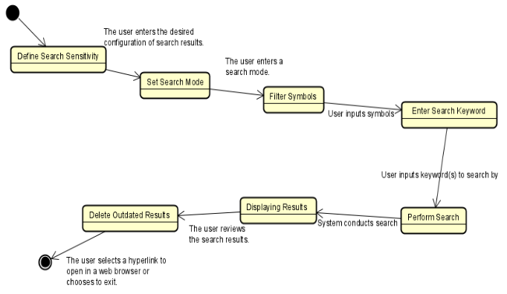
State Transition Diagram
Use Case
Sequence
Class

Slide 18
04
Code & Demo
Overview Of Our Project

Slide 19
Search Handler Class
Overview
What does this section do?
Highlights how the function uses input parameters like keyword, count,, min_year, sortOrder to create highly customizable search queries. This enables precise information retrieval based on unique requirements.
Emphasize the function's ability to filter and sort search results based on the last published date and alphabetical order of titles. This sophisticated feature ensures that the search results are always relevant and organized, enhancing the usability of the data retrieved.
Completed
Next Steps

Slide 20
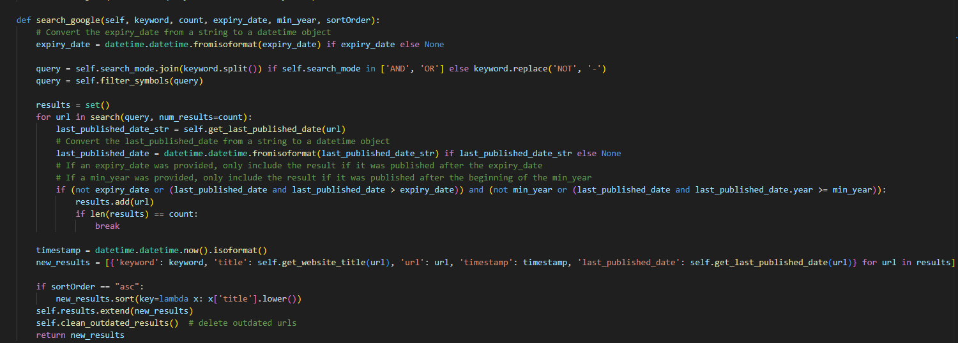
Overview
Completed
Next Steps

Slide 21
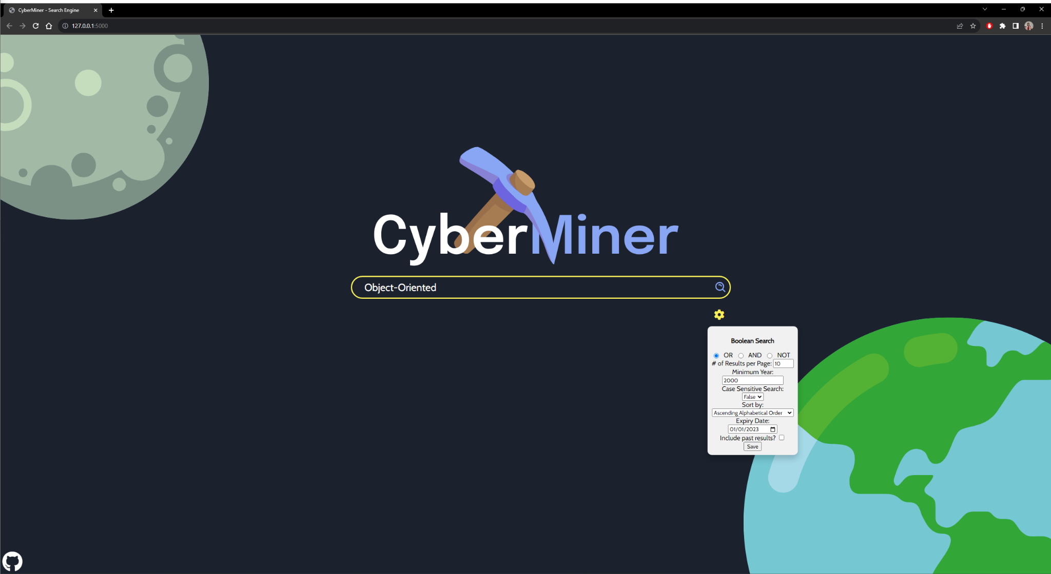
Example - Object-Oriented

Slide 22
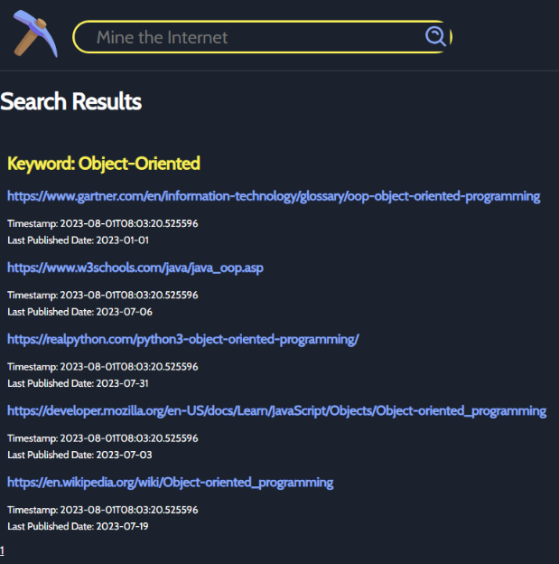
Example - Results

Slide 23
DEMO

Slide 24
Thank You!

